Slide 1

Product Owner Roadmap Presentation
Georgi Zdravkov Georgiev

Slide 2
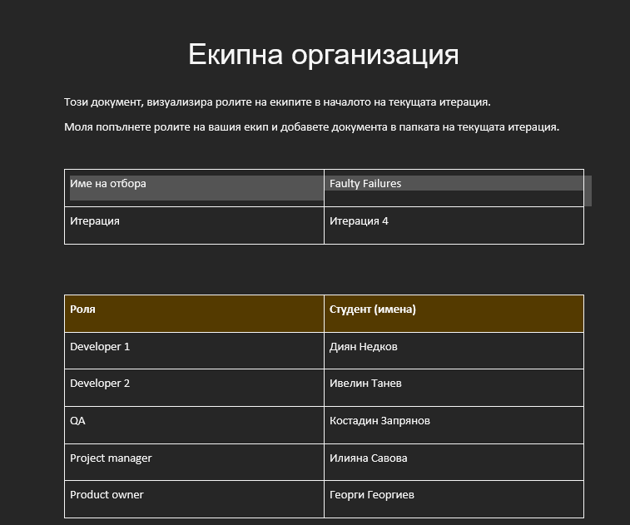
Team Organization

Slide 3
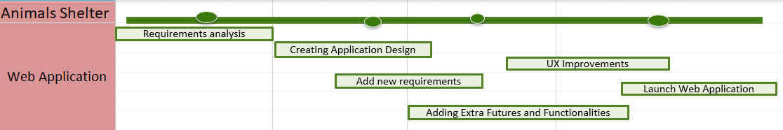
Web Application Aspect

Slide 4
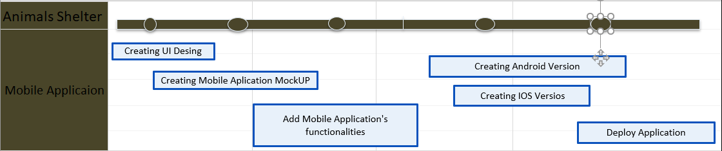
Mobile Application Aspect

Slide 5
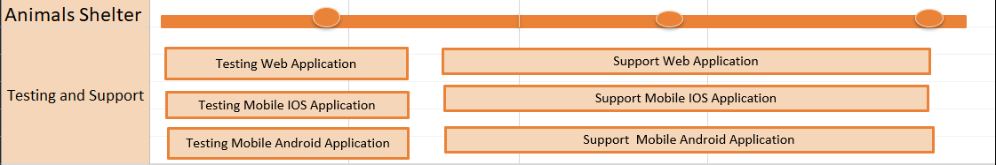
Testing and Support

Slide 6
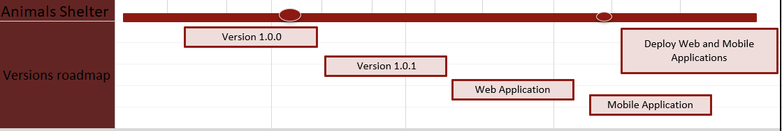
Versions Roadmap

